Slide 1


Aircraft Safety Analysis
Prepared By: Felix Mwendwa

Slide 2
Overview
This project aims at;
Identifying potential risks of aircraft.
Determining aircraft with lowest risk for a company.
Giving insights on purchasing and operating commercial and private enterprises, for a company aspiring to expand into the aviation industry.

Slide 3

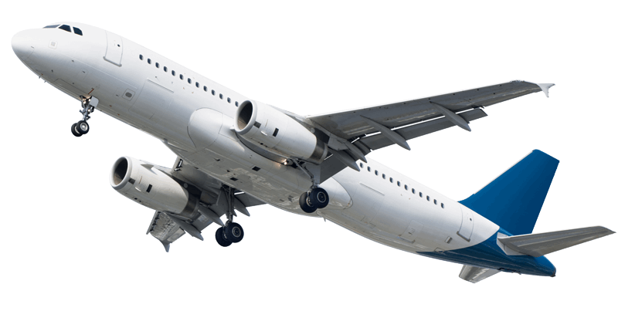
Business Understanding
My company seeks to expand into the aviation industry, and I am tasked to ensure a successful entry by identifying the lowest-risk aircraft options for both commercial and private operations.
I need to delve into and analyze the potential risks associated with aircraft ownership and operation, and provide actionable insights to guide the head of the new aviation division in making informed decisions about aircraft purchases.

Slide 4
Data Understanding
The data being used is from the National Transportation Safety Board (NTSB) aviation accident database.
It contains information from 1962 to 2023 about civil aviation accidents within the United States, its territories and possessions, and in international waters.
The key variable used include:
Make (Aircraft)
Total Fatal Injuries
Number of Injuries

Slide 5

Data Preparation
Data
Selection
Here I decided the data which I will use in the analysis.
Data Cleaning
Missing values where handled and irrelevant columns were removed.
Data Formatting
Made syntactic modifications to the data without changing its meaning.

Slide 6
Recommendations
Here are the key recommendations for the company based on the analysis made:
The company should consider purchasing aircrafts manufactured by Embraer because they were not involved in as many fatal injuries in accidents compared to other aircraft makes. Additionally, they are fuel-efficient, versatile, and well-suited for regional and short-haul operations.
The company should also consider purchasing aircrafts manufactured by Airbus as they did not suffered fewer accidents leading to fatal injuries compared to other aircraft makes. Moreover, they are renowned for reliability, fuel-efficiency, and short-haul commercial flights.
The company should consider purchasing twin-engine or quad-engine aircraft as they did not suffer as many accidents as single-engine aircraft, and they are commonly used today.
The company should also consider selecting aircraft models with proven reliability and strong manufacturer support.

Slide 7
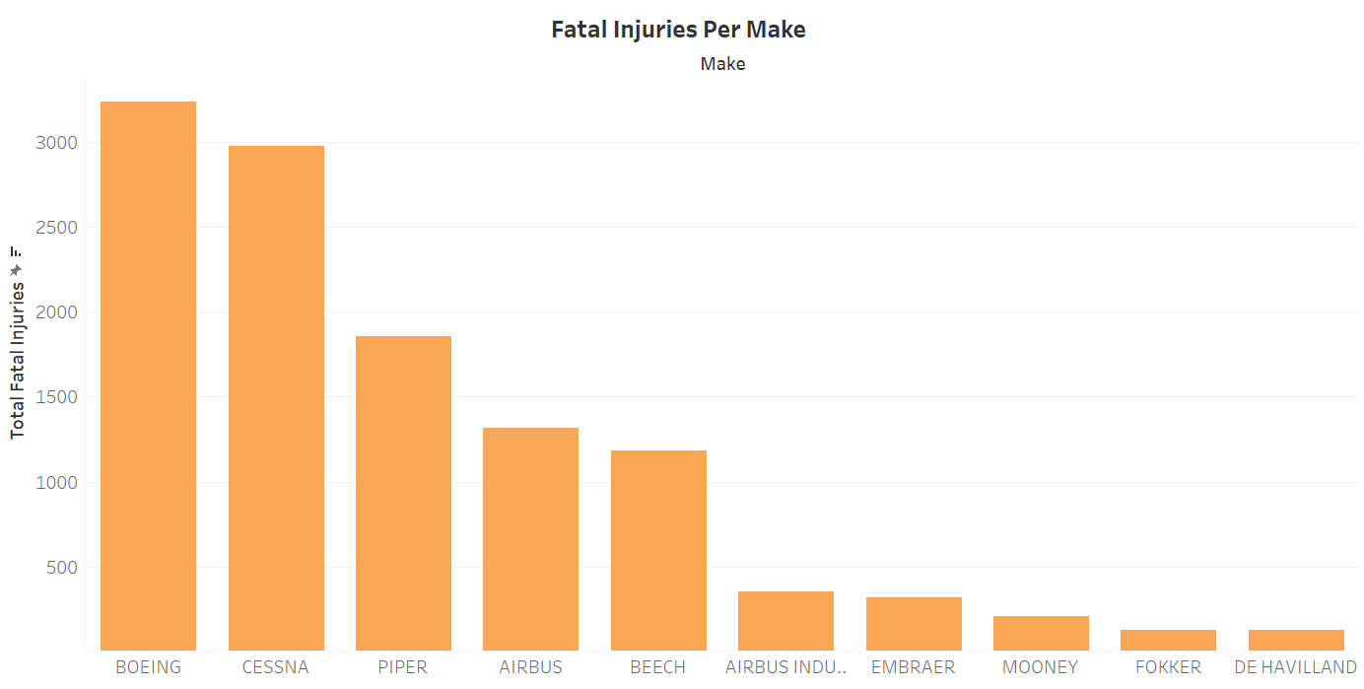
Total Fatal Injuries By Aircraft Make
The visualization shows the number of fatal injuries suffered per aircraft make

Slide 8
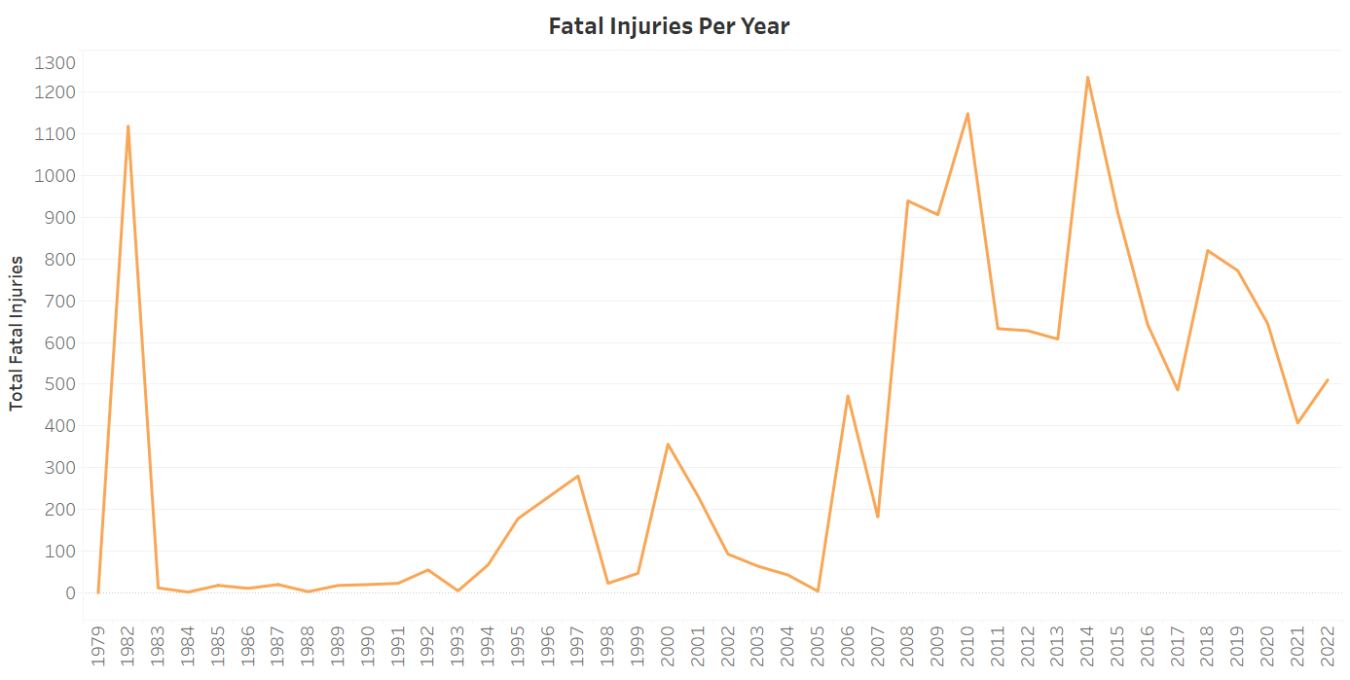
Total Fatal Injuries By Year
The visualization shows the number of fatal injuries suffered per year

Slide 9
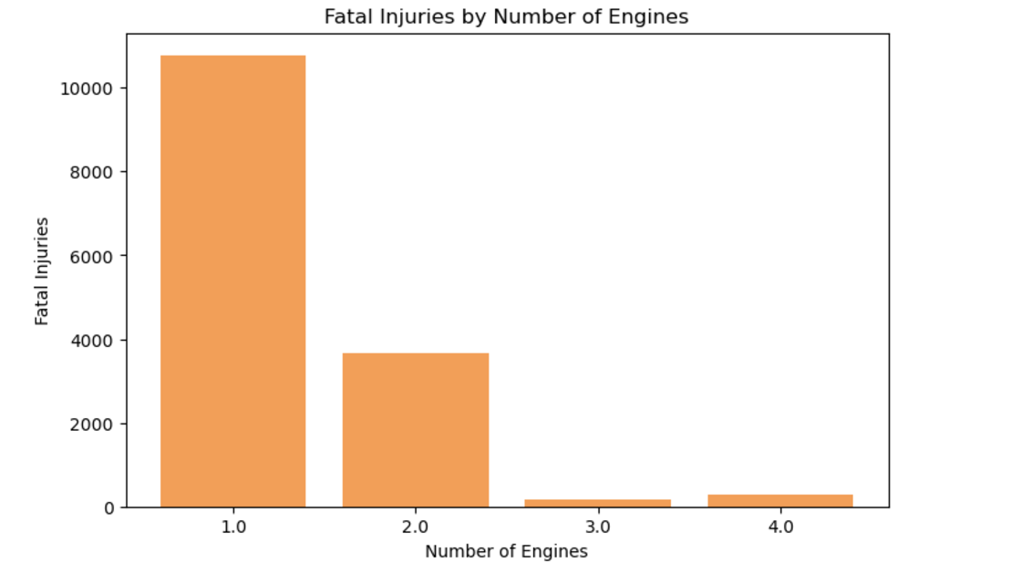
Total Fatal Injuries By Number of Engines
The visualization shows the number of fatal injuries suffered per the number of engines in an aircraft

Slide 10
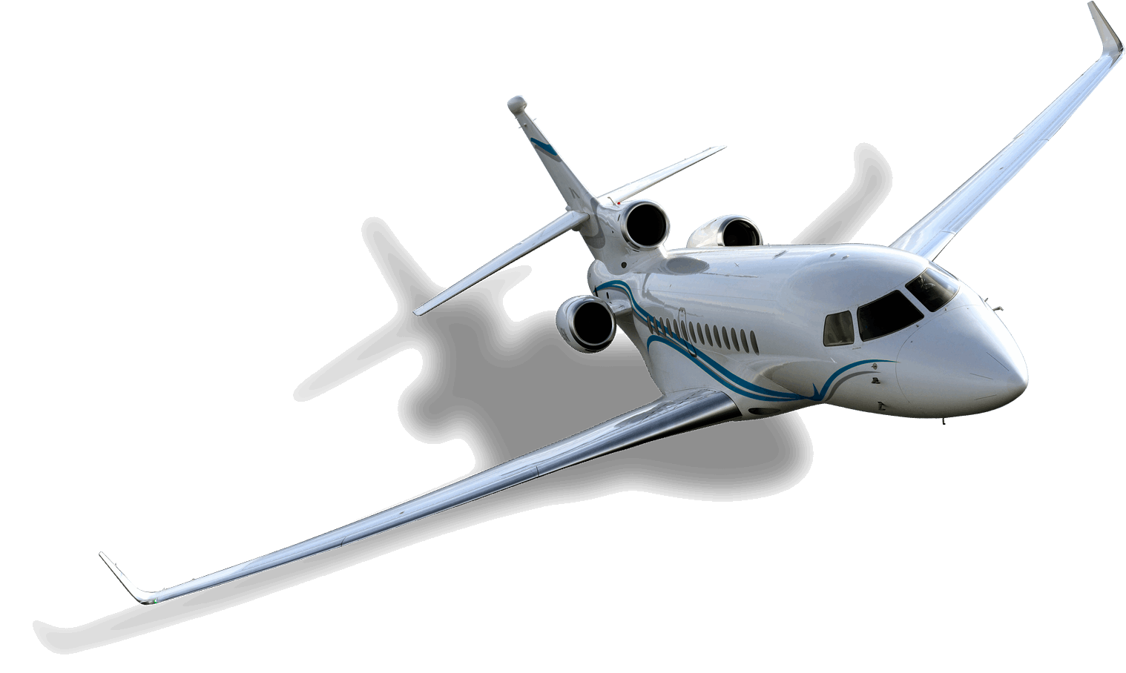
Conclusion
Space Utilization
Ingenious design strategies optimize airport layouts, making the most of limited space, enhancing functionality, and adapting to urban constraints for efficient operations and passenger experiences.

Slide 11
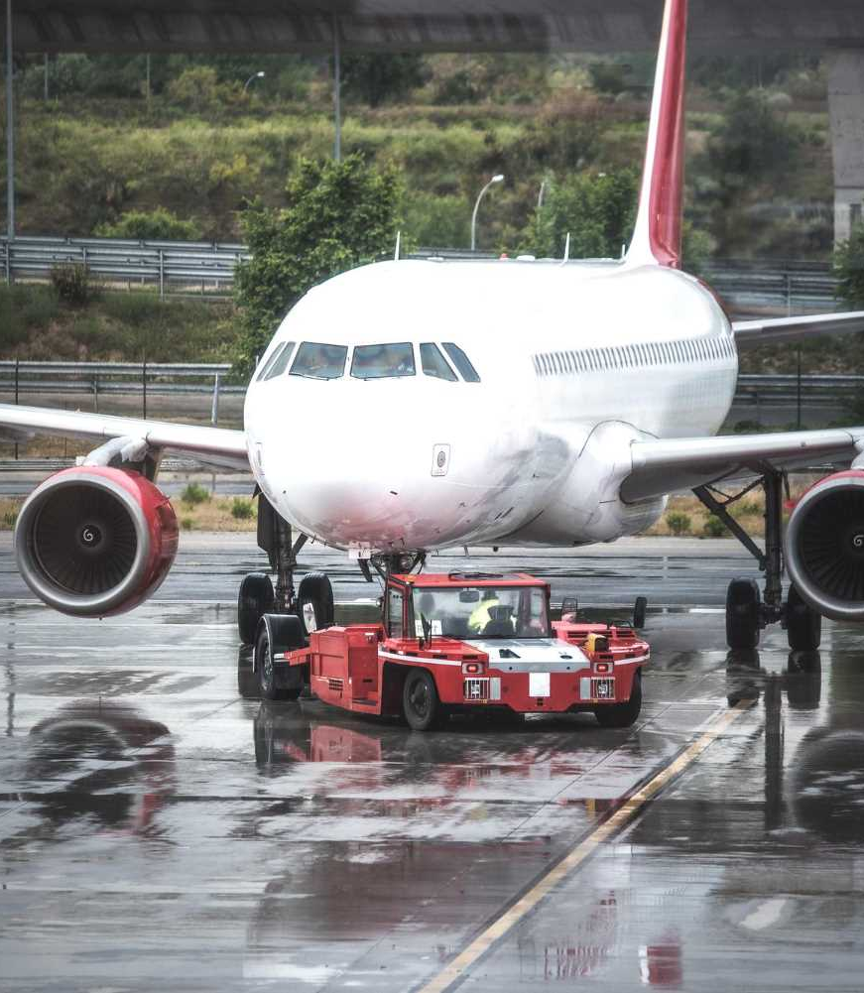
Key risk mitigation factors
Evaluation and Future Improvement Ideas
Thorough Due Diligence
Robust Risk Management Strategies
Regulatory Compliance
Continuous Aircraft Monitoring

Slide 12



Thank You!
Incase of any question reach me

